Slide 1
DVT-PROJECT IN TABLEAU (Car Insurance)
File created on: 2/10/2025 4:40:32 PM

Slide 2
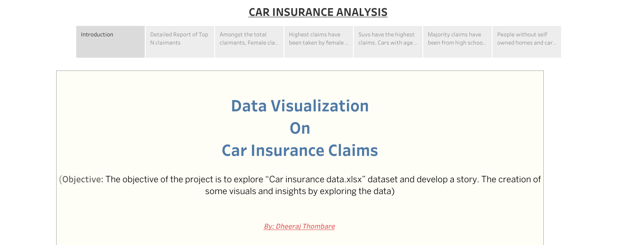

Slide 3
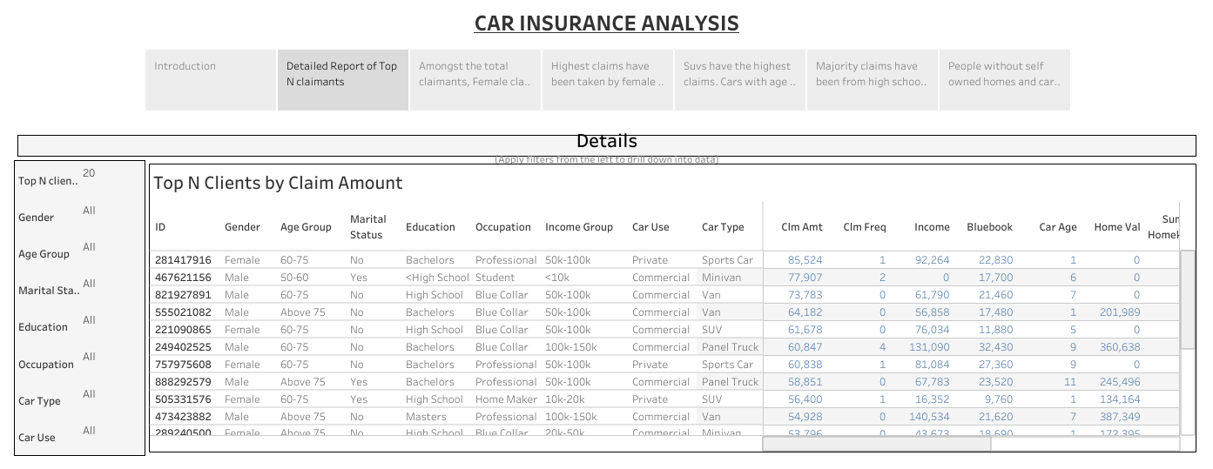

Slide 4
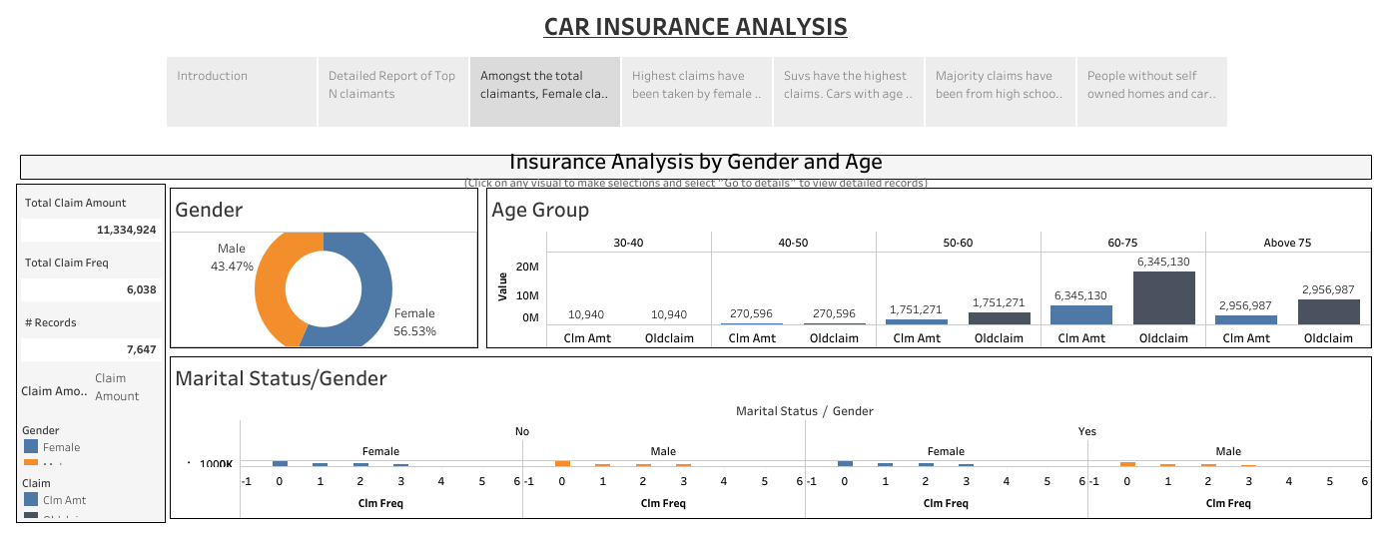

Slide 5
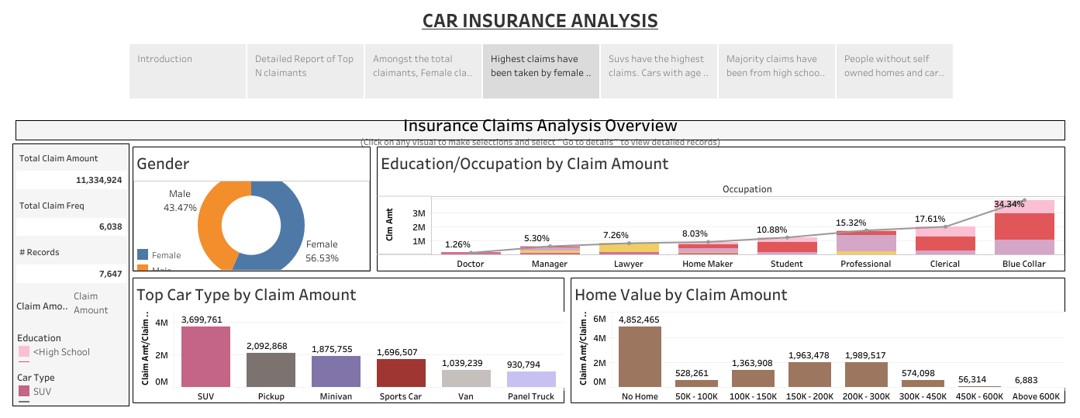

Slide 6
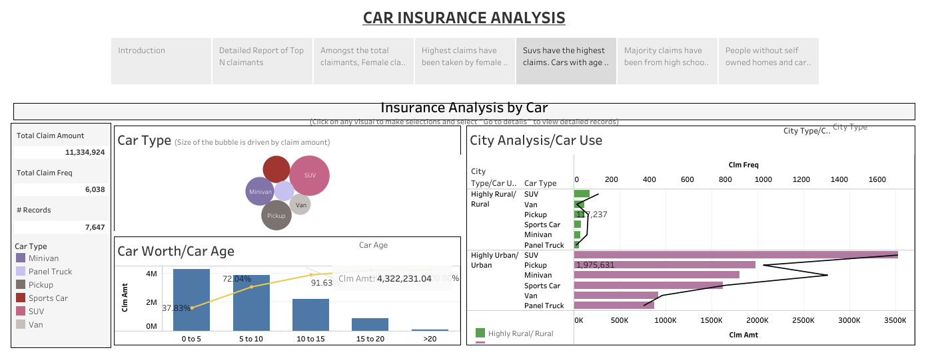

Slide 7
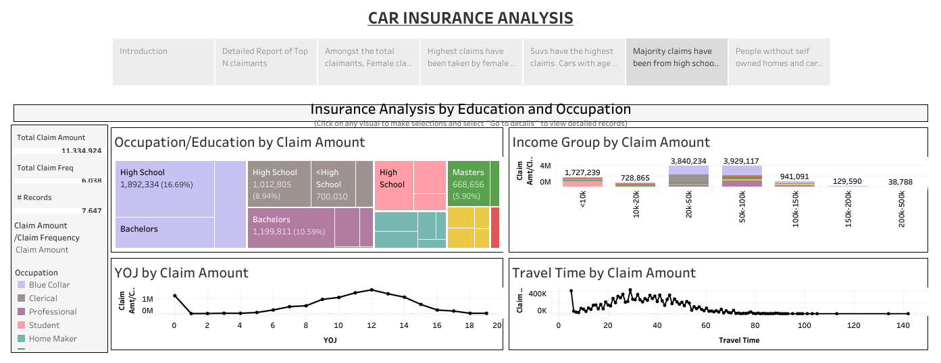

Slide 8
